Slide 1

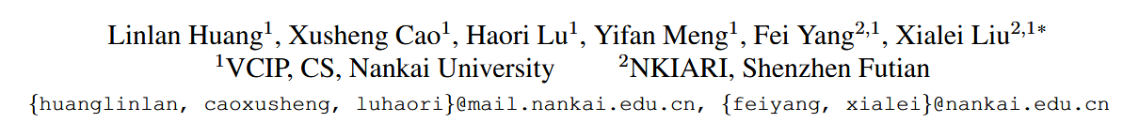
Mind the Gap: Preserving and Compensating for the Modality Gap in CLIP-Based Continual Learning
ICCV 2025

Slide 2

Background
The goal of continual learning is to enable models to continuously acquire new knowledge and adapt to the everchanging real world. Traditional approaches to continual learning focus on training a model from scratch, aiming to reduce catastrophic forgetting of old task knowledge while maintaining plasticity to adapt to new data.
With the recent development of large-scale pre-trained models, these models offer stronger stability and generalization capabilities for continual learning . Among pre-trained models, visual language pretrained models such as CLIP demonstrate excellent generalization to downstream tasks, showcasing impressive zero-shot capabilities. Consequently, CLIP-based continual learning (CL) has emerged as a promising new direction, attracting increasing attention from researchers.

Slide 3
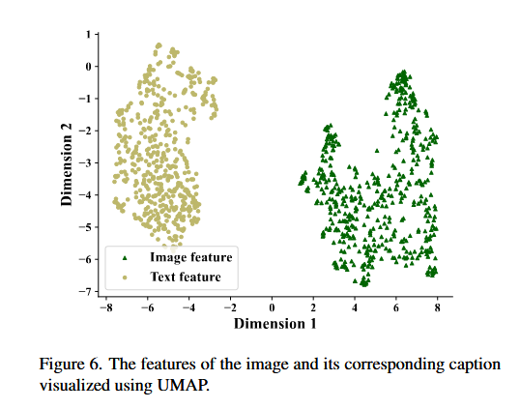
Background
Existing CLIP-based continual learning methods can be broadly categorized into two approaches::
Fine-tune the backbone to modify feature representations;
Freeze the backbone and add learnable modules for continual learning.
Most approaches treat CLIP as a text-enhanced visual model, focusing on feature fusion or text-guided feature adaptation.while often overlooking CLIP’s cross-modal nature and the modality gap that differentiates it from unimodal systems.
Researchers focus on reducing the modality gap in pre-trained multimodal models. However, in the context of continual learning with CLIP, our objective is to retain the strong generalization capability of the model while learning new data. Thus, how to handle the modality gap in continual learning remains an open question. Our work is based on the assumption that this modality gap reflects the intrinsic knowledge of the pre-trained model.
Notes:
以往方法只把 CLIP 看作一个带有文本提示的视觉模型，做一些特征融合或微调，
但没有意识到 CLIP 的真正优势在于它的跨模态对齐结构。
忽视这一点，就会破坏它与文本空间之间的模态关系（modality gap），
从而失去预训练知识的迁移能力。
本文正是针对这一问题，提出在保持模态间隙稳定的同时，补偿视觉判别能力的方案。

Slide 4
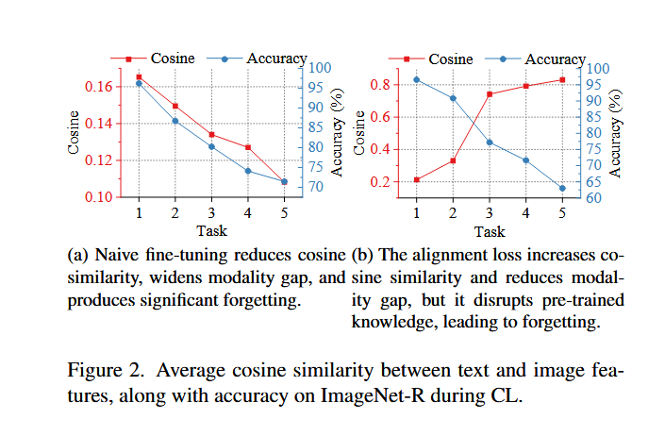

Motivation
Dual Dilemma of Stability-Plasticity
Stability: Naive fine-tuning expands the modality gap and destroys the geometric imprint of pre-trained knowledge (Fig. 2a).
Plasticity: Directly aligning the modality gap (by introducing alignment loss) reduces the gap, but due to the limitations of downstream data distribution, it leads to overfitting and forgetting of old knowledge (Fig. 2b).
余弦相似度计算：
Notes:
朴素微调为了适配下游任务，会 “破坏原始 CLIP 的模态结构（预训练知识的‘几何印记’）”，导致模型失去预训练带来的泛化能力。
下游数据分布 “量少且单一”，强行缩小模态鸿沟会让模型过度拟合下游数据，同时 “遗忘” 预训练阶段在海量数据上学到的通用知识。只追求 “稳定”（靠朴素微调维持预训练结构），会因模态鸿沟扩大而无法适配下游；
只追求 “可塑性”（靠对齐损失强行适配下游），会因过拟合 / 遗忘而丢失预训练优势。

Slide 5
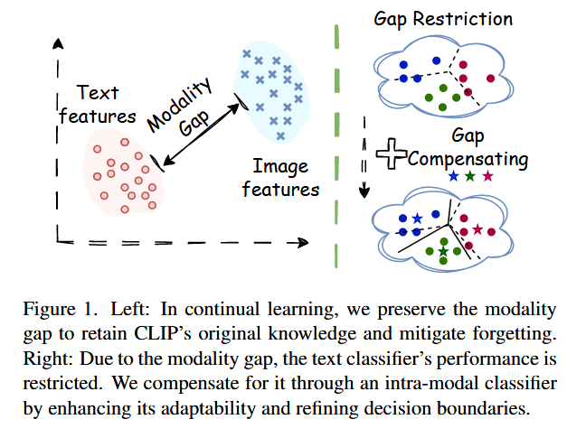
Motivation
In CLIP-based continual learning, the modality gap between image and text embeddings plays a crucial role in preserving pre-trained cross-modal knowledge. However, existing methods tend to destroy this gap during fine-tuning, leading to catastrophic forgetting. Motivated by this, we propose to explicitly preserve and compensate for the modality gap to maintain knowledge stability and enhance adaptability across tasks.

Slide 6
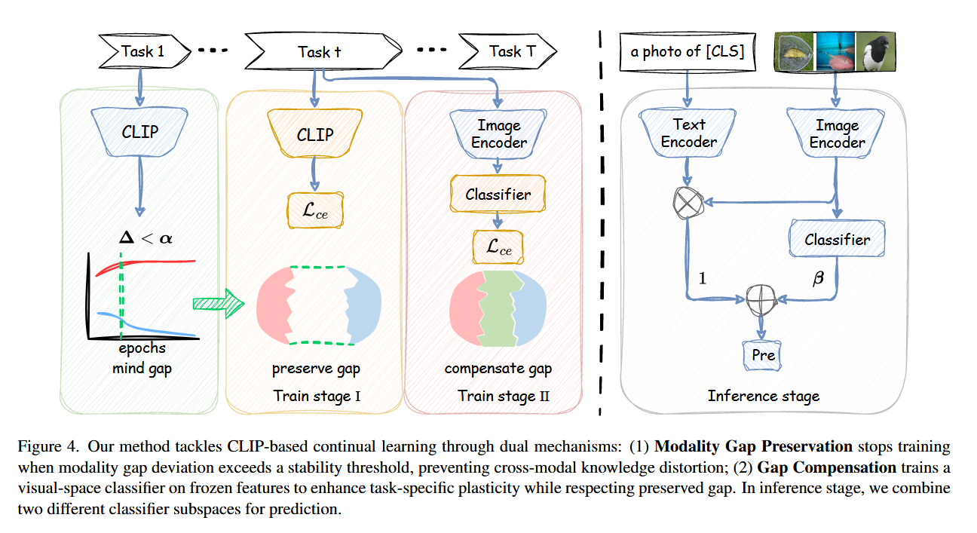
Methods

Slide 7
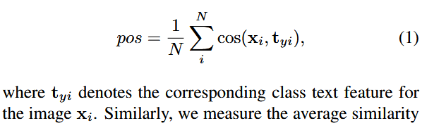
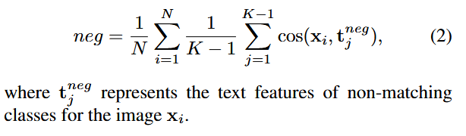
Methods
Modality gap measure
In the classification task, given N images and K class name of text, we measure the intermodality similarity as the average cosine similarity between all image and text features:
where xi is an image feature and tj is a text feature. This captures the overall similarity between the image and text modalities, reflecting the modality gap in the feature space.
1、positive image-text pairs
2、negative image-text pairs

Slide 8
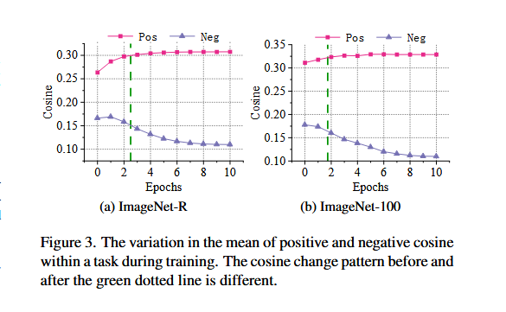

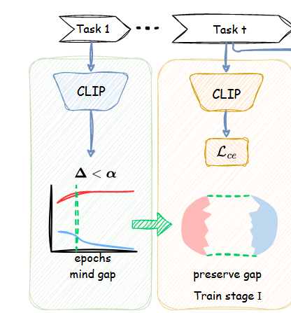
Methods
1、Adaptive Modality Gap Preservation
When the difference ∆ exceeds a predefined threshold α, we record the last epoch e where ∆ was still below α. Finally, for all tasks in the downstream dataset, we train the model for the max(e, 1) epochs.

Slide 9
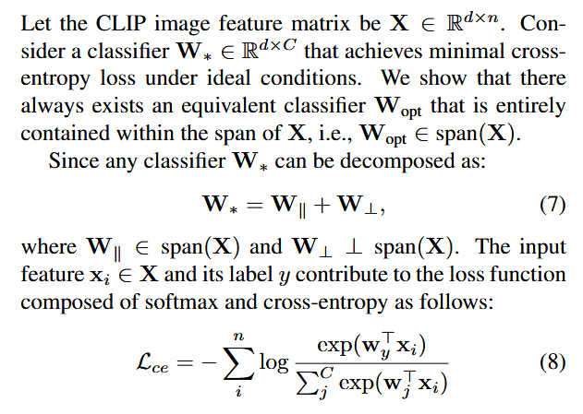
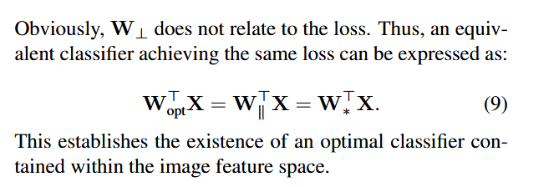
Methods
2、Intra-modal Compensation for Modality Gap
(1)Existence of an Optimal Classifier within Image Feature Space

Slide 10
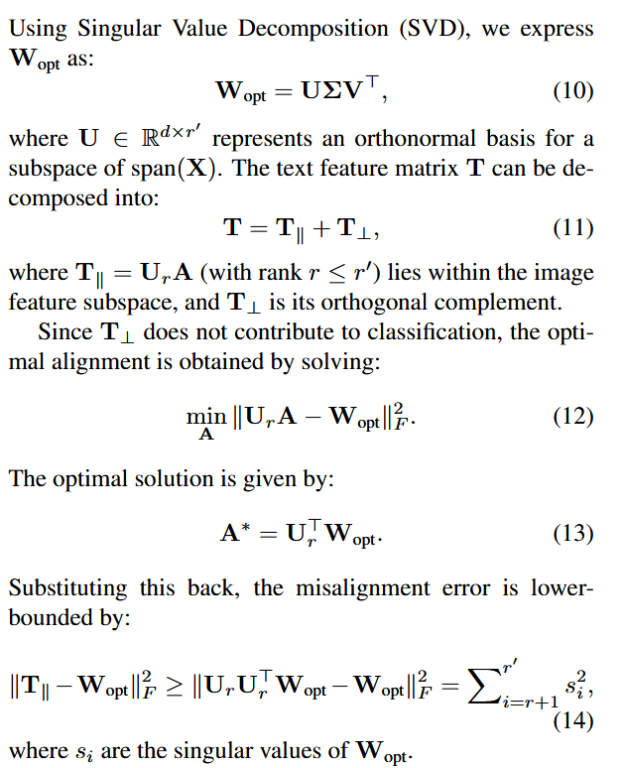
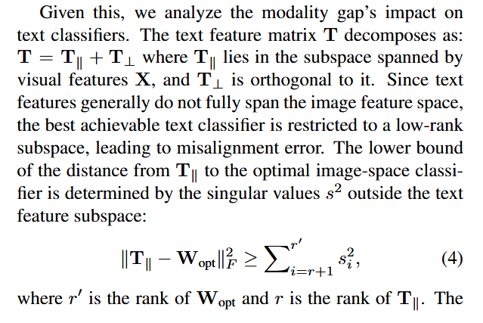
Methods
2、Intra-modal Compensation for Modality Gap
(2)Restriction Imposed by Modality Gap on Text Classifiers

Slide 11
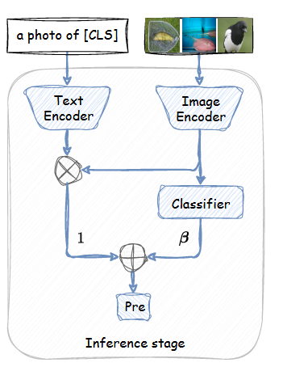
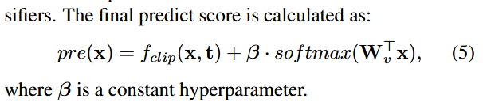
Methods
2、Intra-modal Compensation for Modality Gap
This result reveals an inherent limitation: unless the text feature space has sufficient capacity to represent the optimal classifier, perfect alignment is unattainable. Due to the modality gap, text classifiers often operate in a lower-rank subspace, restricting their classification effectiveness.

Slide 12
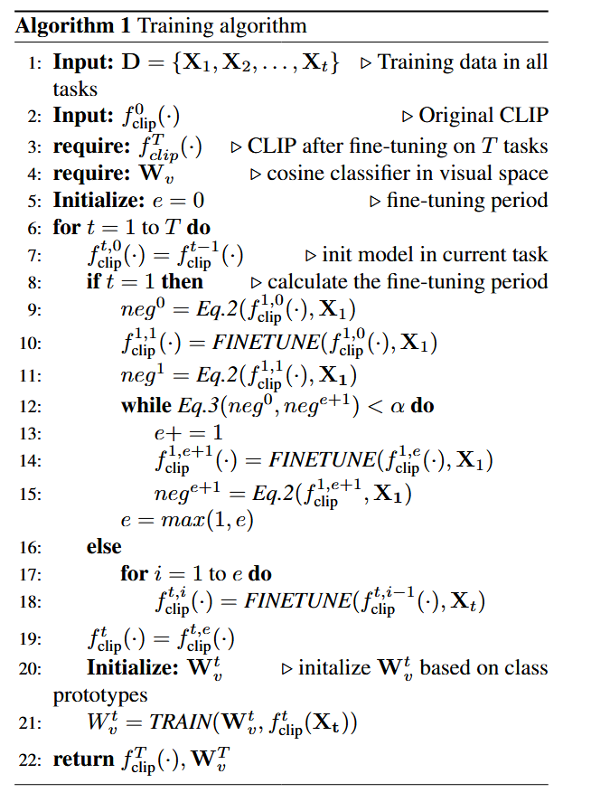
Methods

Slide 13
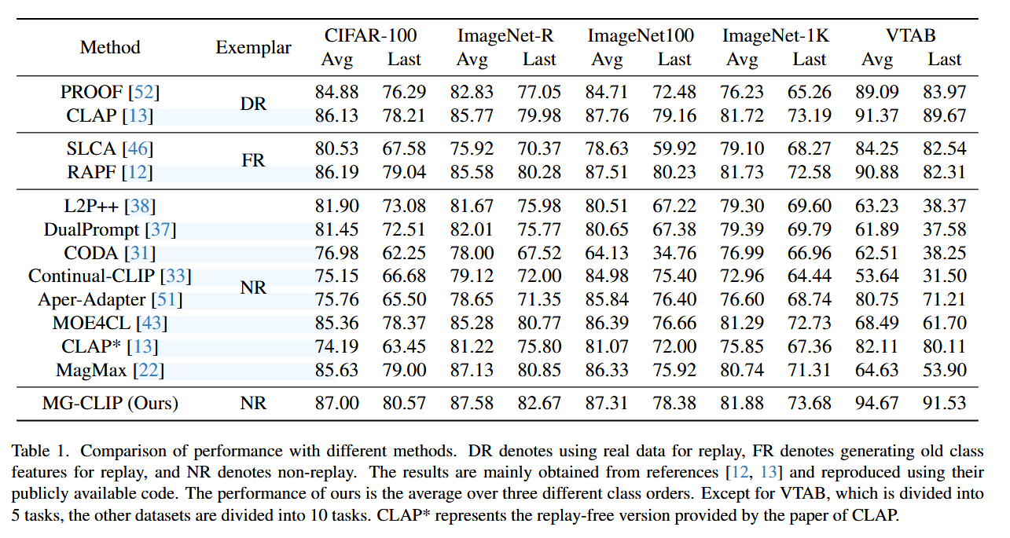
Experiments
Datasets
CIFAR-100：日常物体的低分辨率彩色图像，60,000 张，100 类
ImageNet-R：含模糊、噪声等扰动的自然图像，约 128 万张，1000 类
ImageNet-100：ImageNet 精选的细粒度自然图像，约 10 万张，100 类
ImageNet-1K：真实世界各类物体、动物等自然图像，约 128 万张，1000 类
VTAB：跨域场景图像，包含19项公开数据集，包括Caltech101、CIFAR-100、CLEVR distance prediction、CLEVR counting、Diabetic Rethinopathy、Dmlab Frames、dSprites orientation prediction、dSprites location prediction等上百万张，本文仅使用其中的50个类别。

Slide 14
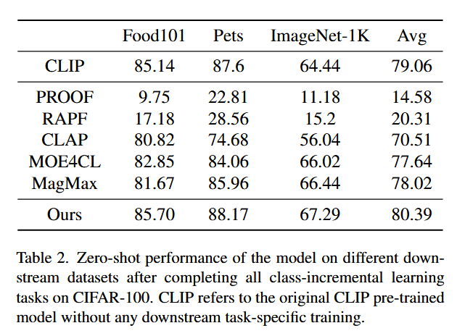
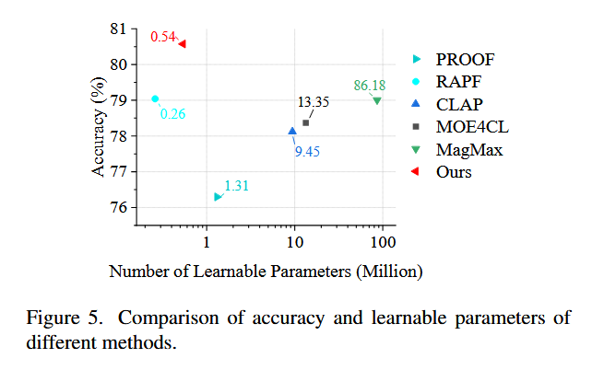
Experiments
Zero-shot Capability
Training Cost Analysis

Slide 15
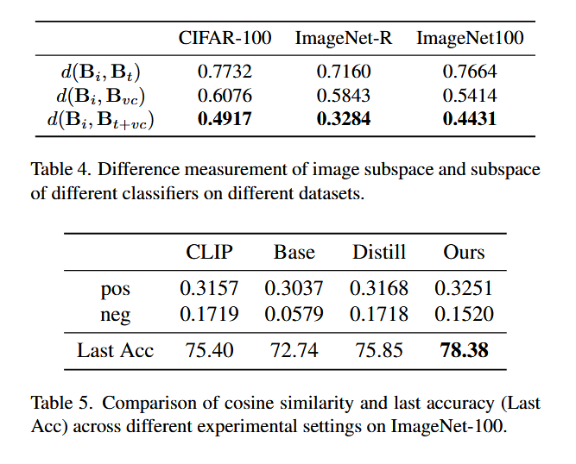
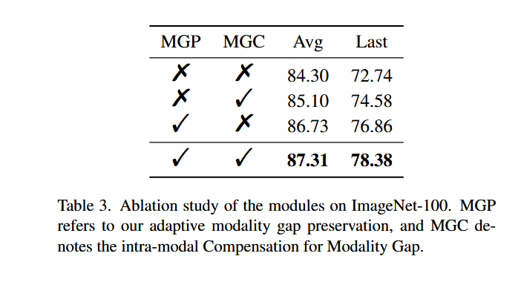
Experiments
Module ablation

Slide 16

Thanks

